Slide 1


Welcome to Owlets Nursery
2025 - 2026

Slide 2

We wear our own clothes to Nursery
After all, the best days end in dirty clothes!

Slide 3
Nursery Parents Meeting: 4th July 2025
Welcome; Meet the team
The Provision
What is the Early Years Foundation Stage?
Nursery: the first few weeks
Communication is key
How to support your child
The week before
Children will need
Other information
Dates
Frequently asked questions

Slide 4
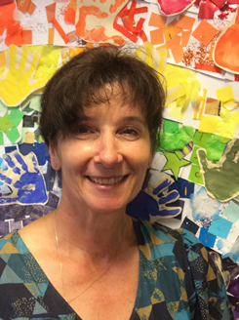

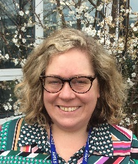

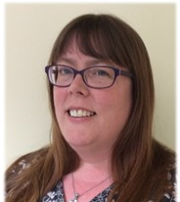
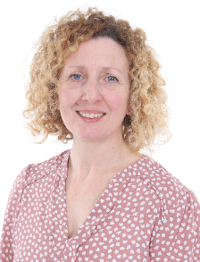

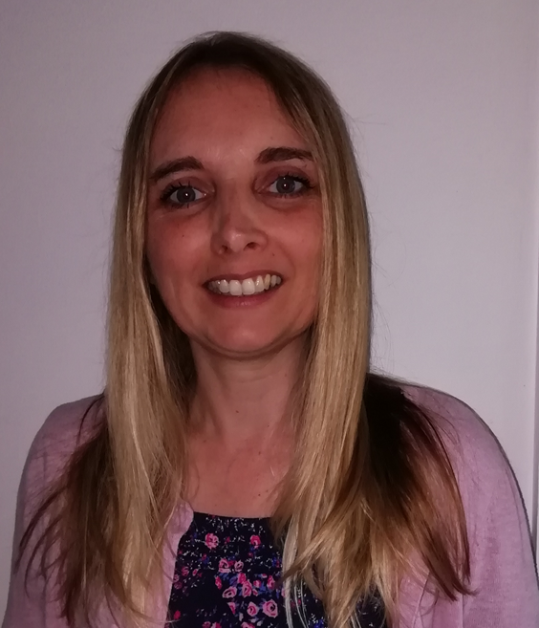
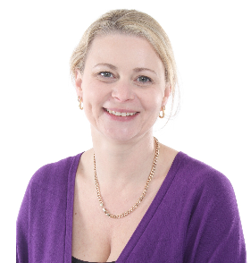
Meet the team:
We have a friendly, caring staff who are experienced and dedicated to provide a warm, stimulating and safe learning environment.
Mrs Clinton:
Nursery Nurse
Mrs Gatzanis:
Early Years Practitioner
Mrs Newton:
Nursery Nurse
Miss Morley:
Class Teacher
Mrs Mclean:
LSA and
lunchtime supervisor
Mrs Castleman: LSA and lunchtime supervisor

Slide 5
Provision: the options
The sessions we offer
30 hours funded place (if eligible) they will attend Nursery between 9am – 3pm
15 hours funded places:
Option 1”beginning of the week children”: all day Monday, all day Tuesday, Wednesday morning until 12pm (including lunch)
Option 2 “end of the week children”: Wednesday from 12-3pm (no lunch on Wednesday), all day Thursday and all-day Friday
Before and after school care:
Camp Glide, from 7.30am- £4.90 (book and pay through their website)
After School Club 3pm -6pm - £12 (pre-booked online using SCOPAY- a link will be sent in a week or two for you to set this up).
(costs may be subject to change)

Slide 6

What is the Early Years Foundation Stage?
The Early Years Foundation Stage (EYFS) sets the standards that all early years providers must meet to ensure that children learn and develop well and are kept healthy and safe.
It covers birth to the end of the Reception year.
Our curriculum is practical and play based enabling children to become independent learners.
Adults plan, support, model and scaffold learning.
What does a typical day look like?

Slide 7
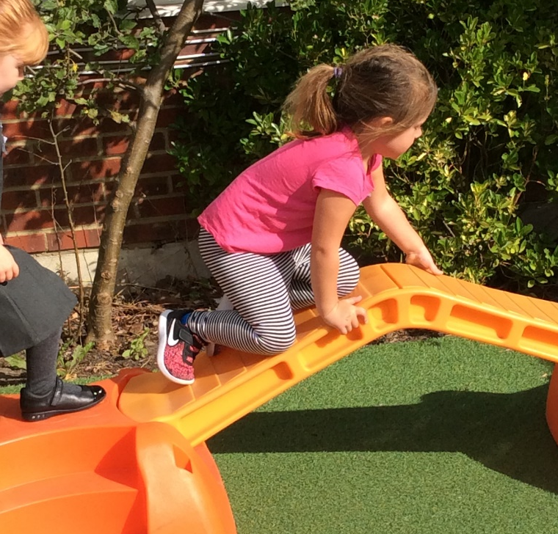
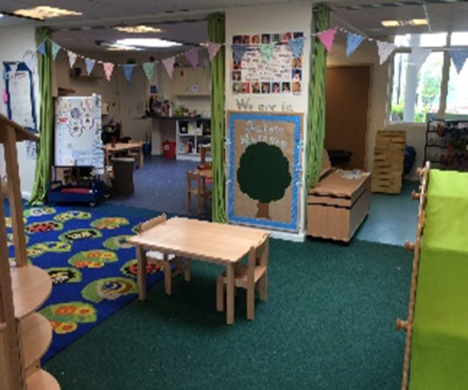
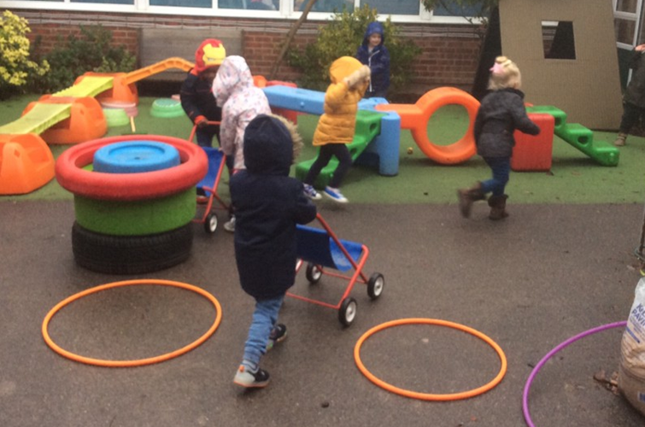
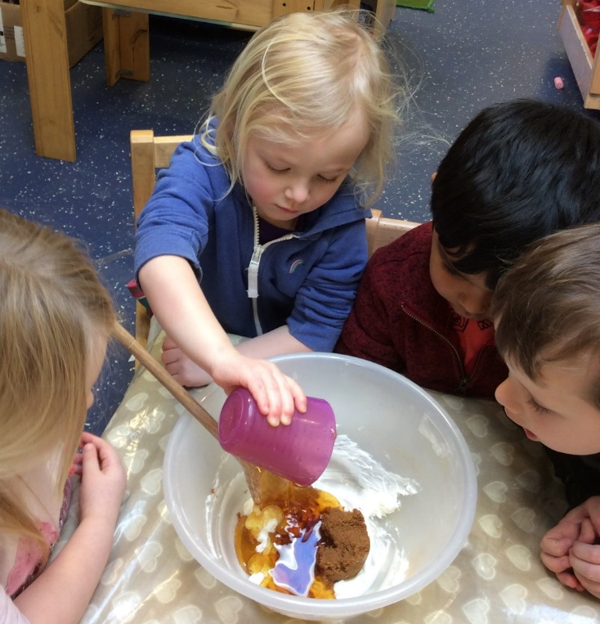
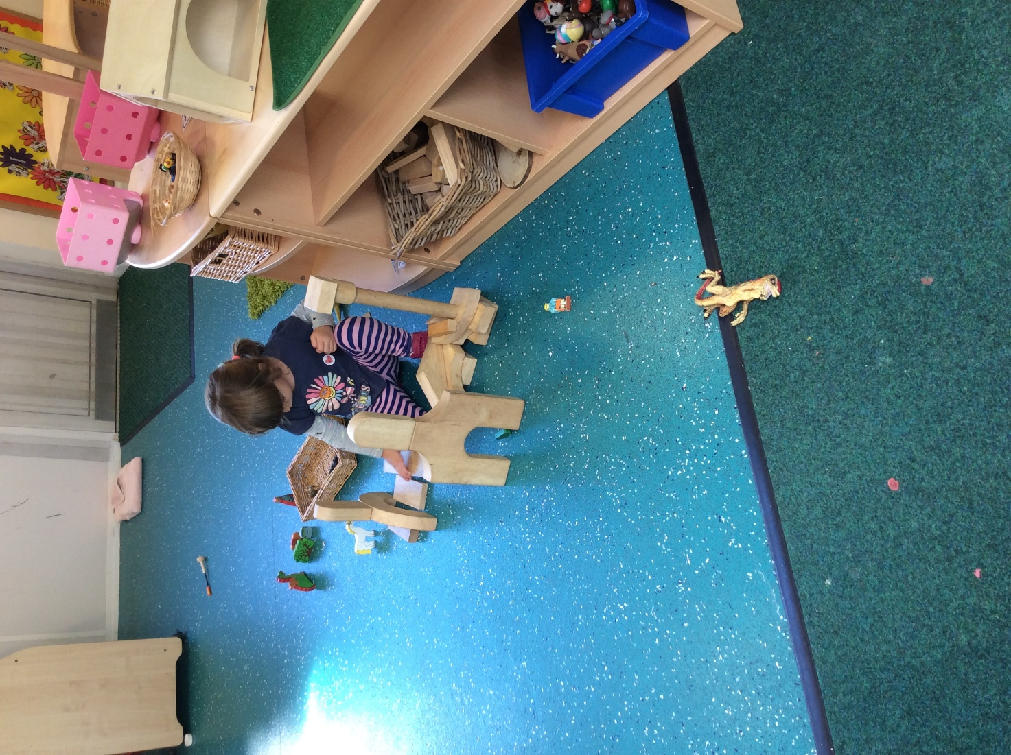
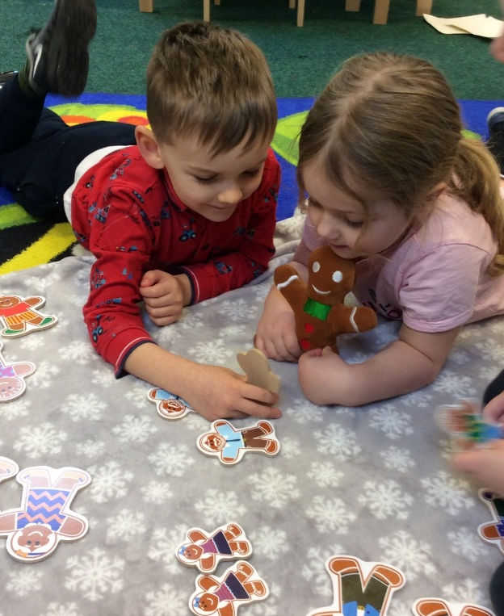
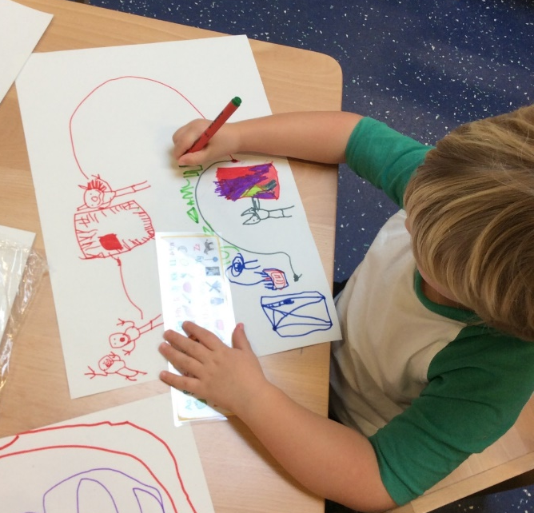
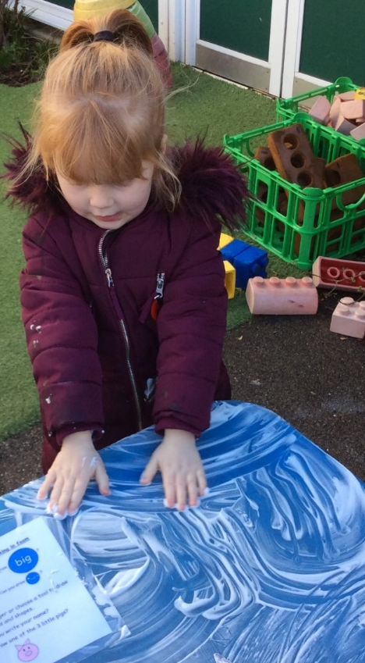
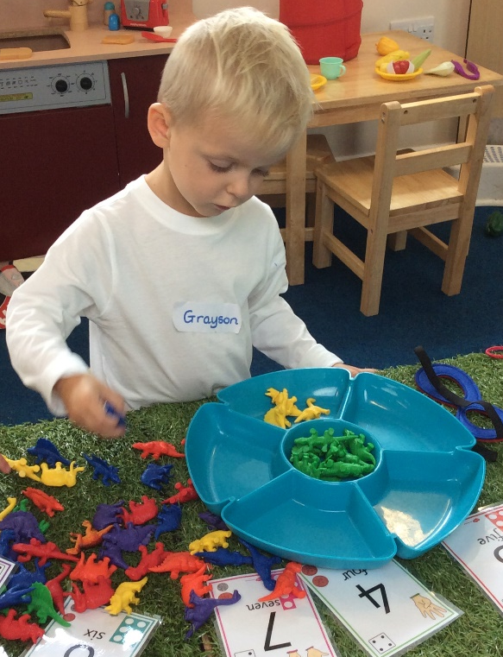
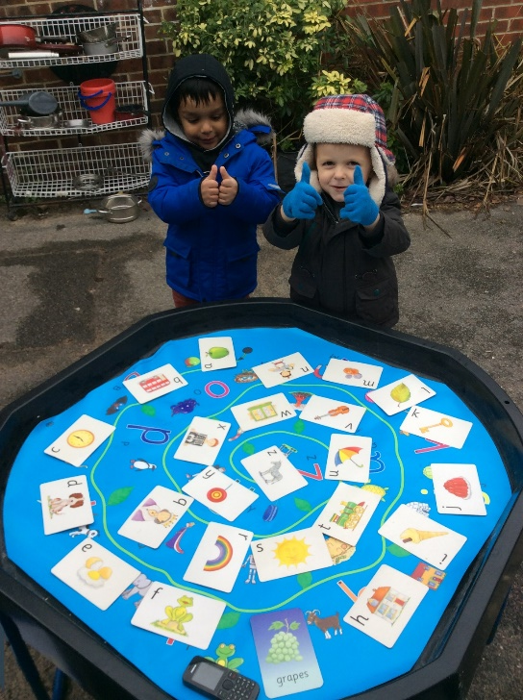
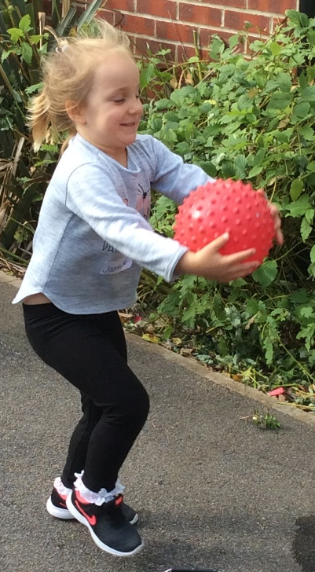
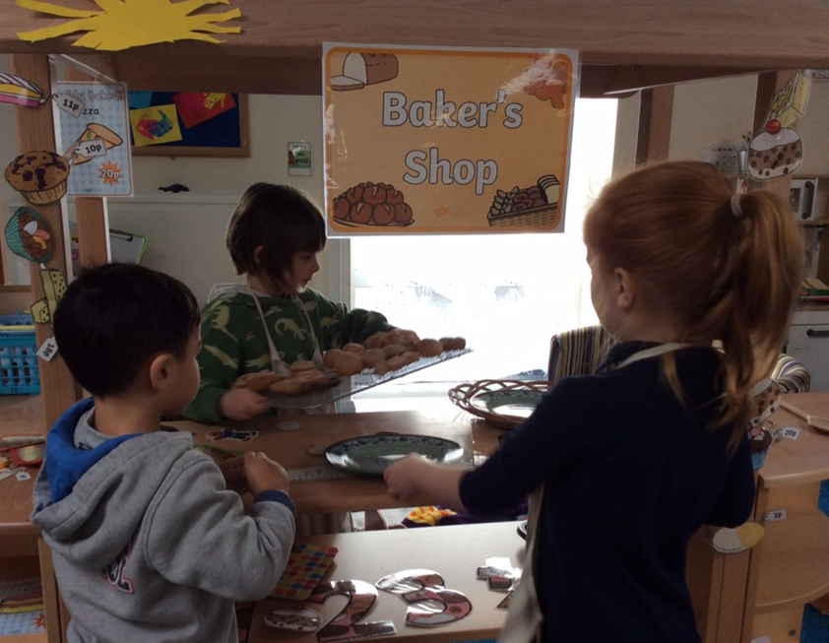
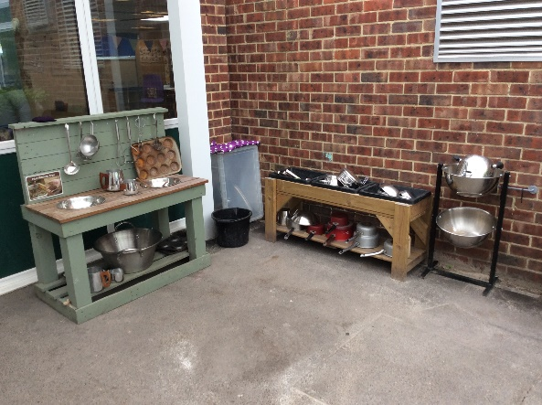

Slide 8


What is the Early Years Foundation Stage?
There is a huge emphasis on:
developing communication and language skills;
reading and listening to stories;
encouraging healthy choices and oral health;
challenging greater depth and understanding.

Slide 9

Nursery: the first few weeks
During the first few weeks we will:
visit you at home;
get to know your child, their likes, and dislikes;
undertake a nursery entry baseline.
Activities:
We carefully plan to provide a range of learning experiences;
We include children’s interests and next steps.
These describe the level of attainment expected at the end of your child’s Reception year in school. At the end of Reception your child will be assessed against the Early Learning Goals for each area of learning and they will be assessed against meeting GLD (A Good Level Of Development).

Slide 10

Communication is key
Any concerns and successes will be raised with you. If you have any concerns, please do not hesitate to contact us.
Face-to-face at the start or end of the day
Call the school office: 01342 842010 or email school@burstow.surrey.sch.uk ​
Studybugs​ - reporting absence
Class Dojo
Please make sure your contact details are correct.

Slide 11

How to support your child at home
Independence is key to being able to take control of their own learning;
Practice dressing and undressing, going to the toilet, pull clothes up and down, wash and dry hands; and teach them to blow their own nose, with a tissue!
Teach them to recognise their own belongings and the first letter of their name;
Teach them to use cutlery when eating; sit when eating;
Play games and teach them how to take turns and share;
Read to and with your child everyday; sings songs and nursery rhymes;
Talk and listen to your child;
Talk about what you see in the world around you;
Play make-believe games by pretending;
Practice following simple instructions;
Give opportunities to ask and answer simple questions;
Talk about and name emotions;
Walk, get physical – gross motor activities are vital;

Slide 12

How to support your child at home
Mark making and pincer grip activities;
Say number names in order to 5.
Play make-believe games by pretending;
Limit time spend on screens;
Encourage a “have-a-go” attitude before asking for help
Be positive as you talk about coming to Nursery;
Ensure your child is properly equipped for school;
Regular attendance is vital;
Attend meetings, parents evening, open days, workshops and events.
​
Parent video: How to say the sounds
https://www.youtube.com/watch?v=TkXcabDUg7Q&t=48s

Slide 13


Reading to your child at home
There can be few things as powerful as regularly reading to a young child.
Yet fewer than half of 0-2 year olds are read to every day/nearly every day by parents
Increasing to 58% of 3-4 year olds (seen as getting them school ready)
Yet by 5-7 years this drops to 44%, as the notion that reading is a subject to learn at school
On the flip side time spent on a screen, even at very young ages, is increasing rapidly.
0–2 year olds spending 1–3 hours a day on screen grew from 11% in 2014 to 42% in 2019.
(Alison David, who spoke at the National Literacy Trusts ‘Talk to your baby’ Conference,2020)
---------------------------------------------------
New data shows many parents unaware that reading aloud to children motivates them to read
There were low levels of reading to pre-schoolers, with boys being read to much less than girls
Boys read for pleasure less than girls do
Dads read to children less than mums do
(from Children’s Reading for Pleasure: Progress, Problems and Practical Solutions: source materials - Nielsen Bookdata’s ‘Understanding the Children’s Book Consumer’ 2022; Farshore/Nielsen BookData 2022 (Farshore’s proprietary data); Nielsen BookData’s ‘Books and Consumers’ 2022)

Slide 14





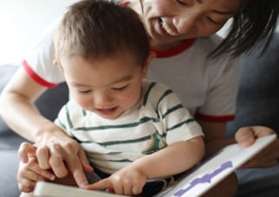


“From babies to children in their early years and all the way through to early teens, reading brings profound and wide-ranging benefits that can have a lifelong positive impact on children’s lives.”
better mental wellbeing and self esteem
better sleep and lead healthier lifestyles
feel more secure and develop deep bonds with parents and carers
more likely to do better at school and make more progress across the curriculum
more likely to develop empathy and creativity
https://www.youtube.com/watch?v=2UmwXQwx5gk “Why read to your child”
https://www.youtube.com/watch?v=eqhwJhd_fNM “10 things to think about when reading to your child”, both from Ruth Miskin training channel

Slide 15

The week before
The week before: start a nursery day routine;
The night before: keep calm and relaxed;
The first day: give yourself plenty of time; come in on the first day, then moving forward, say a happy “bye-bye” at the gate;
If they cry be calm and positive, smile, reassure them you will be back later, then go. Avoid promises of sweets or a present.
Log on to your Class Dojo, we can always send you a picture.
It is normal for children to experience a range of emotions, and for them to pick up on how you are feeling too.
Show you are happy, positive and excited for them.

Slide 16

Children will need
Please label all of your child’s belongings (even their socks!).
Wednesday morning we have hall time. No tights please.
We advise Velcro shoes.
A bookbag (not a ruck sack).
A water bottle.
A bag of spare clothes.
Nappies, wipes and nappy sacks if required.
Wellies.
Weather appropriate coats and hats.
NO Crocs, no shoe laces, or open toed shoes; shoulders should always be covered; sun cream applied BEFORE nursery.
No toys in school unless requested please.

Slide 17
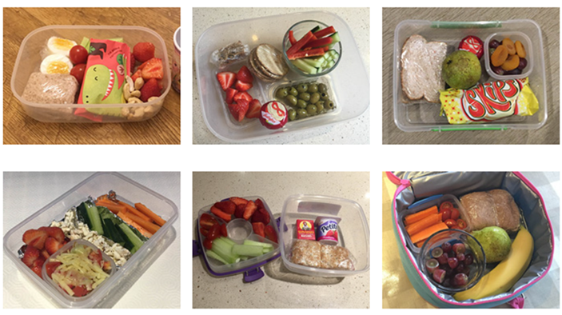

Other information
Food and drink:
School dinner or packed lunch?
Packed lunches: Please do not overload your child’s lunchbox
Healthy eating policy
Dietary requirements
Milk and snacks
Water bottle: filled with water; named and not carried in book bags!
Birthdays – no cakes or sweets

Slide 18
Dates
Home visits: Tuesday 4rd – Monday 8th September (for those who have not had one before)
“Stay and Play”: Tuesday 9th September, an opportunity for you and your child to spend time together in Nursery, exploring the space, finding coat pegs, asking questions and meeting new friends.
First day at Nursery: Wednesday 10th September
  Full time children will stay all day – 9-3pm
  ‘Beginning of the week” children – 9-12pm (including lunch)
  ‘End of the week” children -12-3pm (joining us after lunch)

Slide 19
Frequently asked questions
Does my child have to be out of nappies? No
My child attends Nursery for the first half of the week, where do I collect him/her? Part time "beginning of the week" children are collected from Woodland door, 12pm Wed.
Do Nursery children have a uniform? The zip-up hoodie is not compulsory; they are free to wear their own clothes (NOT THEIR BEST CLOTHES OR CLOTHING THAT ARE DIFFICULT TO MANAGE).
Do I take my child’s spare clothes bag home every day? No, please leave it with us.
My child has dietary requirements and/or medical needs, should I inform Nursery? Yes
If my child has a place in Nursery will they automatically get a place in a Reception class at Burstow Primary School: NO
How do I book and pay for lunch and After School Club? SCOPAY, you will be given a code a week or two after your child joins
Do I have to pre-book Breakfast Club or Early Starters? Yes. Breakfast Club is booked through Camp Glide. Early Starters only, pay through SCOPAY or cash, but you do not need to pre-book.
Can I pay for extra Nursery sessions? At this time we are unable to offer this.
If someone different is collecting my child what should I do? Please inform a member of staff in advance if any other person will be collecting your child, or call the school office during the day.

Slide 20

Remember….
No question is too small or too silly. If you have thought of it, someone else might want to hear the answer too.
We aim to ensure that your child’s experience at Burstow is a happy and rewarding one, where they thrive, become confident learners and well rounded individuals.
We look forward to working with both you and your children.
See you in September!

